Slide 1

Welcome to Class 2.
September 2026.

Slide 2
Class 2 Staff
Miss Dixon - Teacher
Mrs Yates - Teaching Assistant

Slide 3
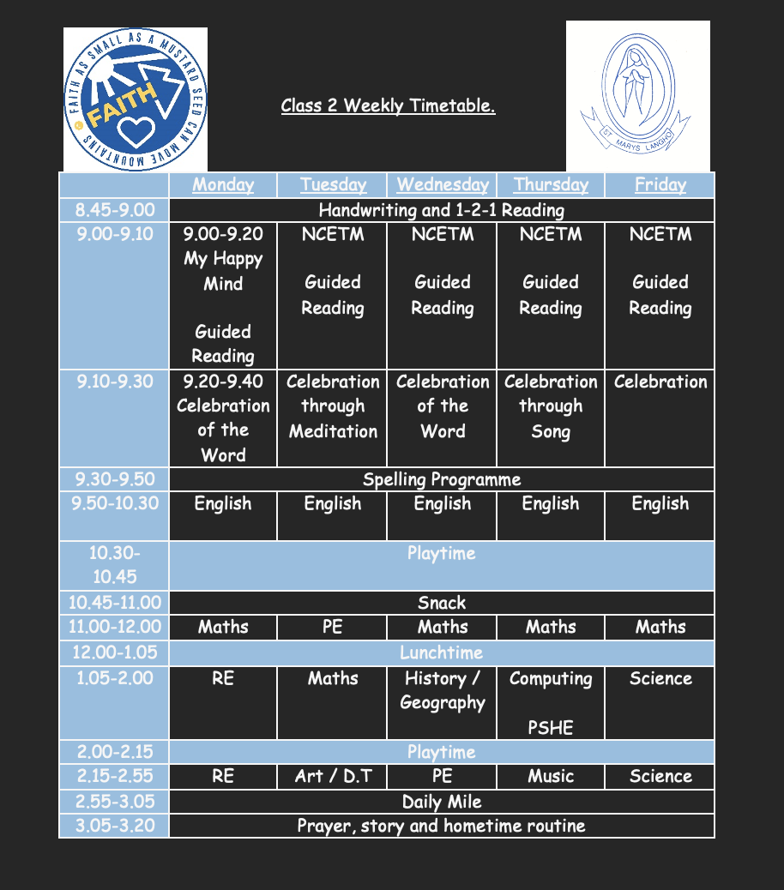
Class Timetable.

Slide 4
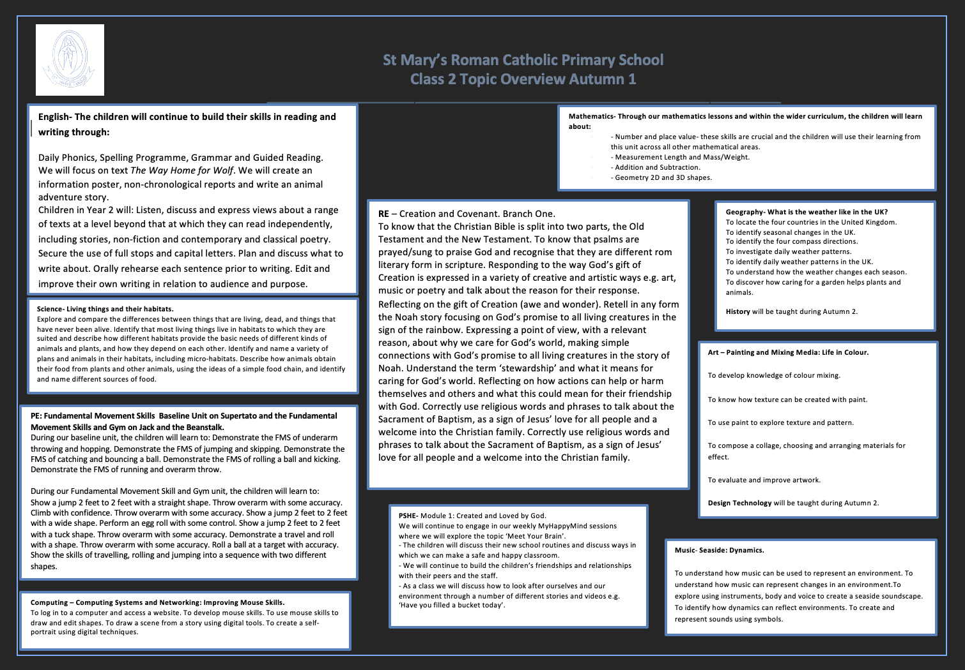
Curriculum overview- available on the website and will change each half term.

Slide 5
Learning and Assessment
Year 2 Expected standard
Spelling, punctuation and grammar
Maths
Reading
Writing
Year 1 Phonics screening retake
Above all else, they are children - they will play, they will explore, and much of their learning will happen through play. Each week, we thoughtfully enhance the environment with specific learning objectives in mind.

Slide 6

Helping your child at home… Homework
Reading is the primary focus of your child’s homework, and they should aim to read daily. Reading books can be changed as often as needed once completed.
However, reading isn’t limited to school books - children are encouraged to explore a wide range of materials, including comics, magazines, newspapers, and more. The key is to develop a love of reading in all its forms.
To support your child’s reading at home:
Encourage them to retell and re-read familiar stories.
Read aloud to them and engage in conversations about the story to deepen their understanding.
Offer an optional half-term writing challenge (e.g. writing a story, diary entry, or letter) to help strengthen their literacy skills.
A homework grid will be available on the school website with challenge cards. These can be completed at any stage during the term.

Slide 7
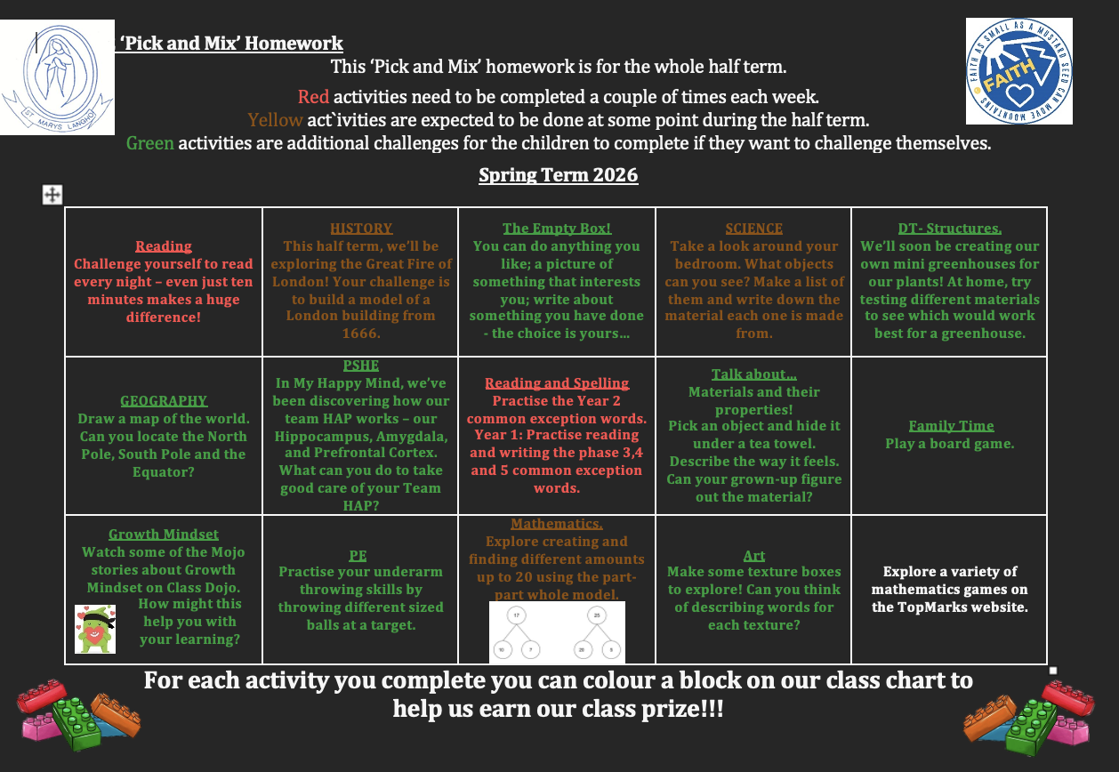

Slide 8

PE
PE takes place every Tuesday and Wednesday.
Children should come to school dressed in their PE kit.
Please ensure all earrings and jewellery are removed before PE sessions.
Make sure all items of the children’s kit are clearly labelled with their name.
Our PE focus for each half term can be found on the curriculum overview.

Slide 9
Snacks and Water
Fresh fruit is provided daily. If preferred, your child may bring an alternative healthy snack.
Children can enjoy school milk in individual cartons. To sign up, please visit https://coolmilk.com/
Children can bring water in a labelled water bottle. Encourage your child to bring their water bottle home each night to wash it and refill it with fresh water for the next day.

Slide 10
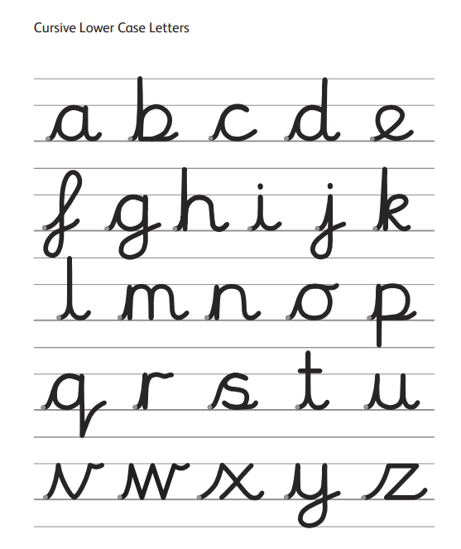

Handwriting- Cursive
Please encourage your child to practise their cursive handwriting regularly to help build confidence and fluency.

Slide 11
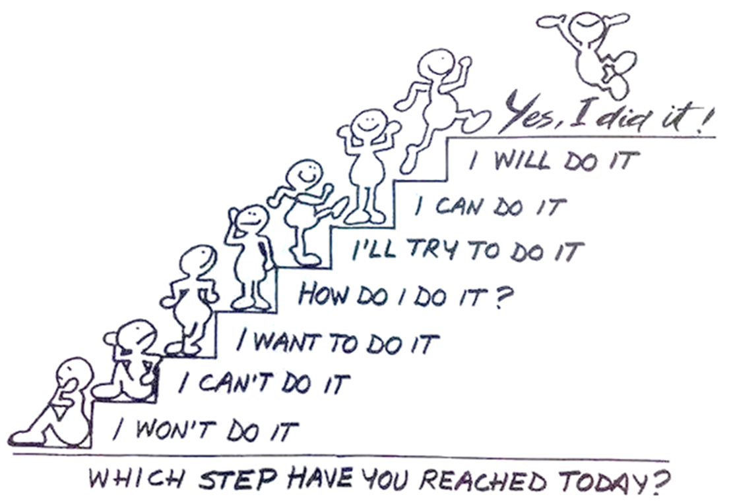



Growth Mindset

Slide 12
Rewards and Sanctions
ClassDojo points
House points
Prize box
Magic 1,2,3!
We aim to address low-level behaviour in class directly. However, if we need to speak with you, we will try to catch you at the end of the school day. If that’s not possible, we will contact you by ClassDojo.

Slide 13
General Reminders
Uniform - Please make sure all items, including PE kits, coats, and water bottles, are clearly labelled with your child’s name.
Books bags only: Please send your child with a book bag. Large rucksacks cannot be accommodated due to limited storage space.
For general information and specific policies, please visit the school website.

Slide 14
Communication
Please stay in touch!
We welcome any questions, comments, or information you’d like to share with us – please don’t hesitate to reach out.
Email: l.dixon@st-marys-langho.lancs.sch.uk
ClassDojo is a great platform for sharing learning updates, school activities, setting homework and celebrating your child’s achievements.

Slide 15
Thank you for joining us!
We’re excited to get to know you this year. If you have any questions, please feel free to email me, and I will do my best to respond as quickly as possible.

